Slide 1


Myocardial Infarction Complications Final Presentation Multivariate Analysis Prof. Maria do Rosário Silva Edgar Varela | 86769​ Marisa Pereira | 88174​ Ricardo Simões | 93674 ​ Théo Di Piazza | 101420 ​ Vicente Sobral | 102134

Slide 2
Contents
Introduction
Dataset Description
Data Processing
Supervised Learning
Unsupervised Learning
Supervised Learning on Clustering
Conclusion

Slide 3
Introduction
Contents
Every year in the United States 200-300 thousand people die from acute myocardial infarction before arriving at the hospital. In the United States, every 29 seconds, one person becomes ill with MI, and every minute one patient with MI dies.​
​
​
B. P. Griffin, Manual of Cardiovascular Medicine. Lippincott Williams amp; Wilkins, 2008.

Slide 4
Dataset Description
123 total variables
89 binary
12 numerical
21 ordinal
1 categorical: final outcome
4 different time windows
Time of arrival at the hospital
End of the:
First day
Second day
Third day
The dataset was retrieved from: www.archive.ics.uci.edu/ml/datasets/Myocardial+infarction+complications

Slide 5
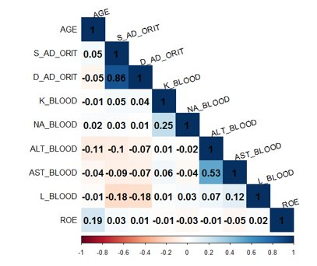
Dataset Description
Correlation
Strength and direction of the linear relationship between 2 variables.
Only 2 features strongly correlated​

Slide 6
Dataset Description
Cramer’s V
Association between 2 categorical features.
Feature 1 | Feature 2 | Cramer's V
MP_TP_POST | Ritm_ecg_p_2 | 0.81
Ritm_ecg_p_1 | Ritm_ecg_p_7 | 0.76
Ritm_ecg_p_2 | N_r_ecg_p_5 | 0.63
MP_TP_POST | N_r_ecg_p_5 | 0.57
FK_STTNOK | IBS_POST | 0.53
High values observed
But none very close to 1

Slide 7
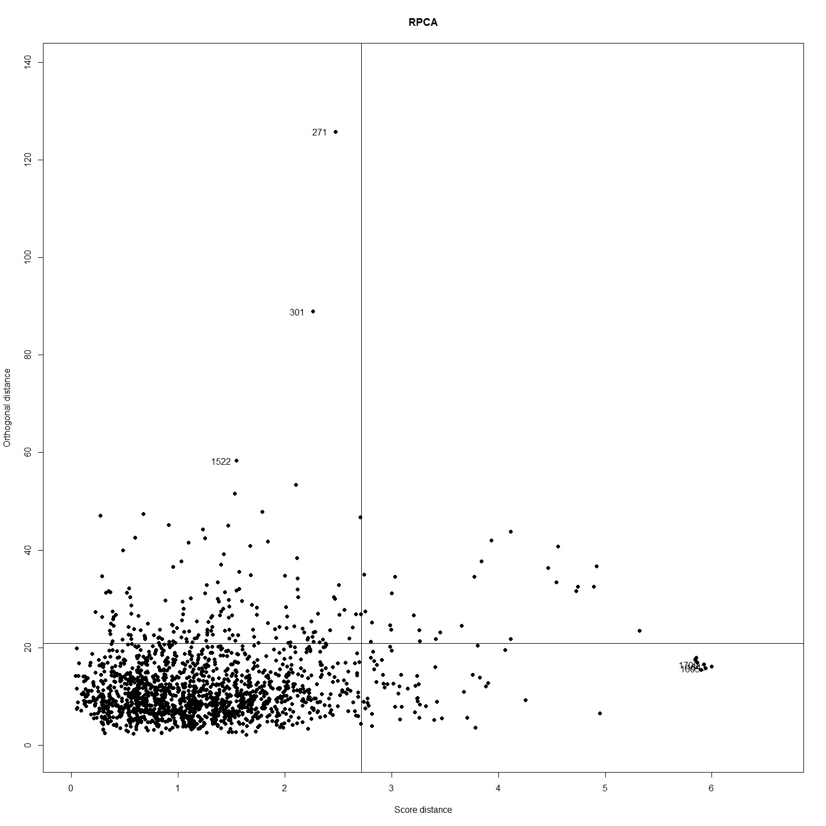
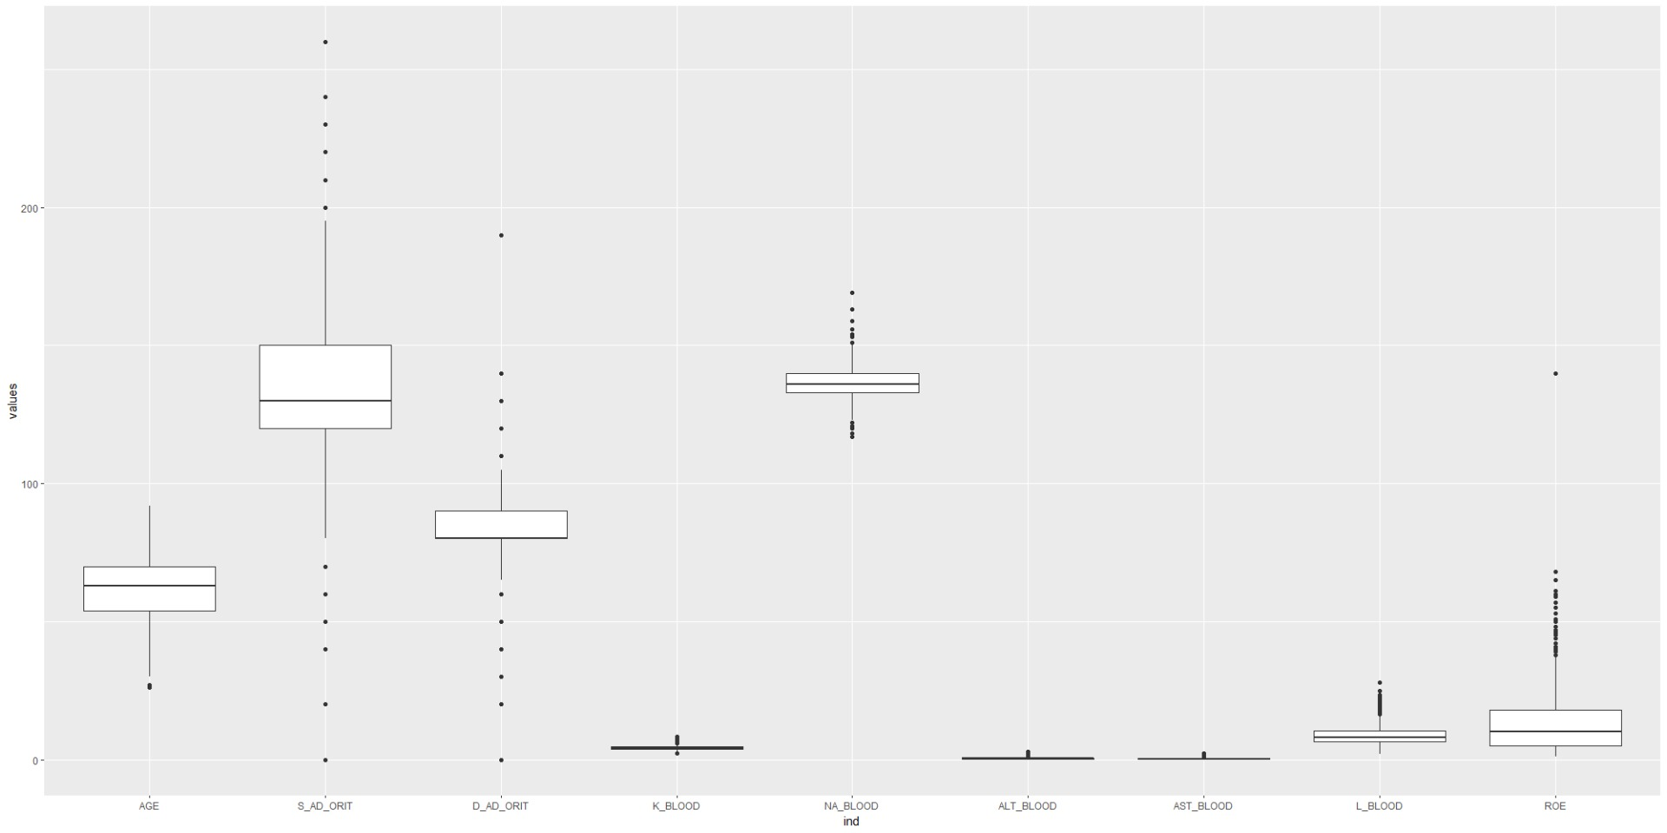
Data Processing
Missing Values Remotion and Imputation
Variables with >25% missing values;
K-nearest neighbours with Gower Distance.
Outlier Detection
RPCA analysis.

Slide 8
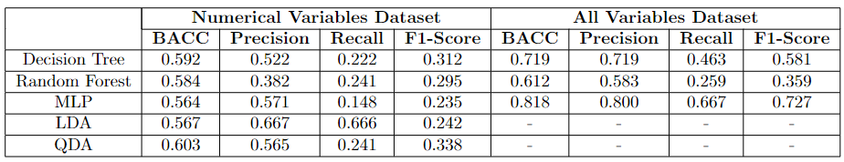
Supervised Learning
Initial Results
Train-test split: 80 / 20 %
5-fold cross validation
Relevant Measures:
Recall
Precision
BACC
F1-score

Slide 9
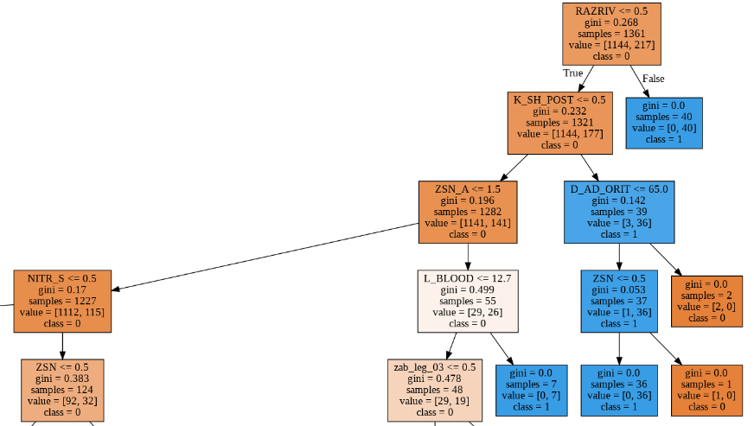
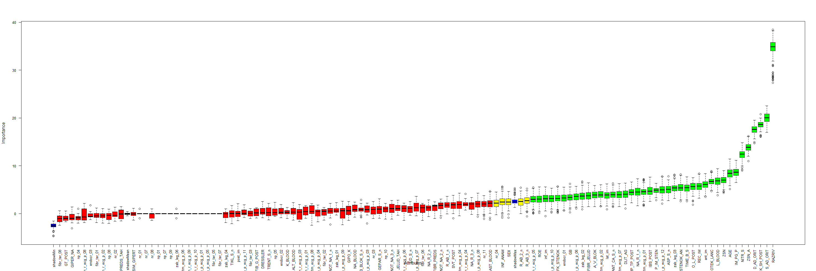
Supervised Learning
Feature Selection
Boruta
BACC = 0.75
Recall = 0.57
Precision = 0.66
F1-score = 0.61

Slide 10
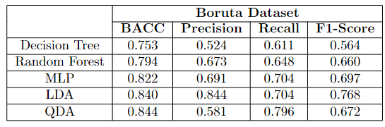

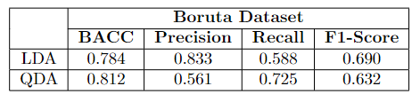
Supervised Learning
Dimensionality Reduction
FAMD

Slide 11
Unsupervised Learning
Clustering Methods
Hierarchical
Partitioning
Single Linkage
Complete Linkage
Average Linkage
Ward method
Diana
Weighted method
Gaverage method
Flexible method
Rock method
K-means
Kernel k-means
K-modes
K-prototype
K-medoids

Slide 12
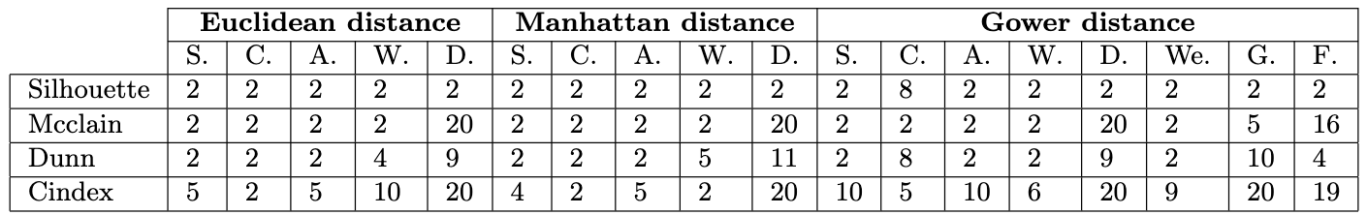
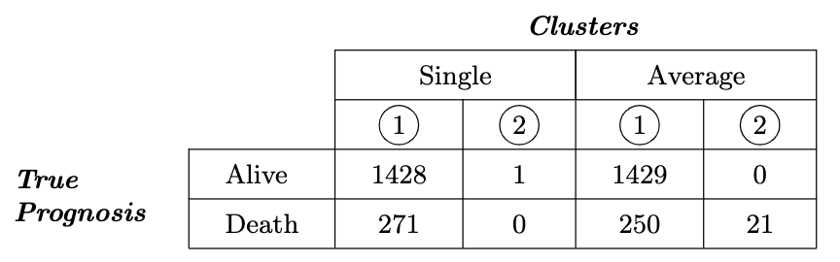
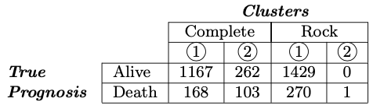
Unsupervised Learning
Hierarchical Clustering Methods
Determinate the number of clusters:
Only with continuous variables:
Only with categorical variables:

Slide 13
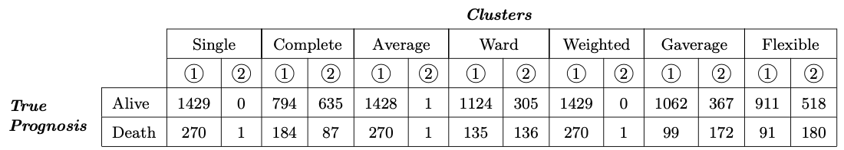
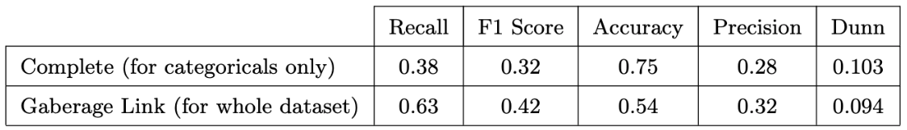
Unsupervised Learning
Hierarchical Clustering Methods - continuation
With all variables:
Cluster validation for the best hierarchical clustering method:

Slide 14
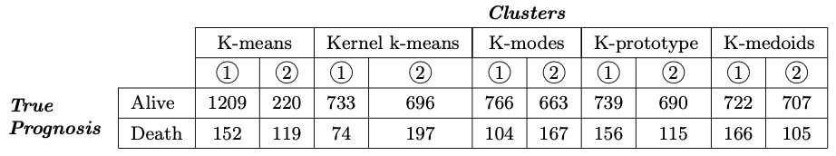
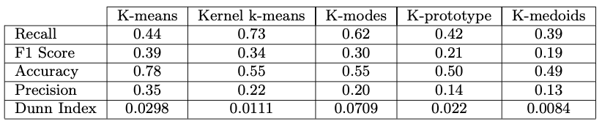
Unsupervised Learning
Hierarchical Clustering Methods - continuation
Resume of the overall results for partitioning clustering methods:

Slide 15
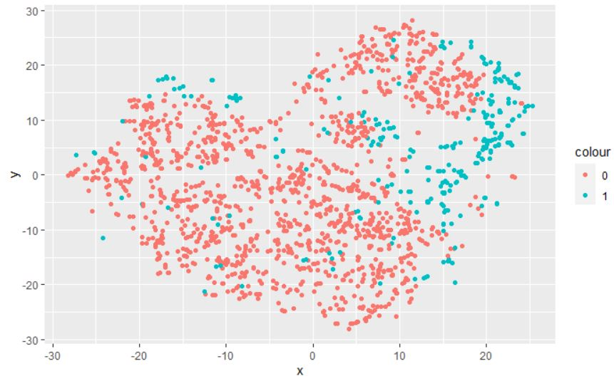
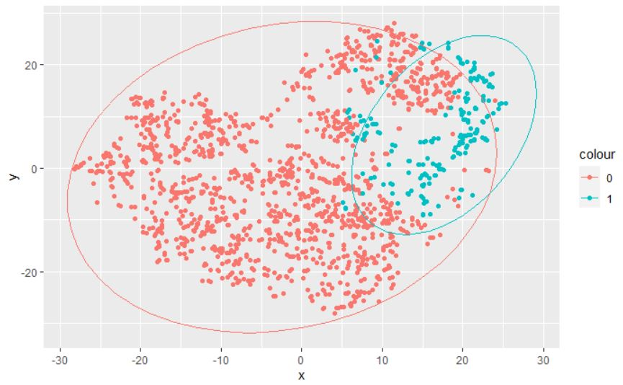
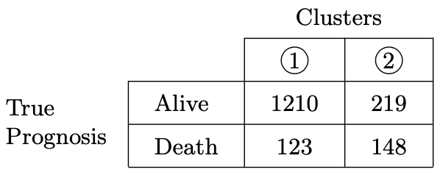

Unsupervised Learning
Manual Clustering with t-SNE
Project data into a 2D space
with t-SNE
Identify a clear cluster with individuals of class 1
Filter points of class 1 far from
the interest cluster
Determine parameters of ellipse
to clearly split the data in 2 clusters

Slide 16
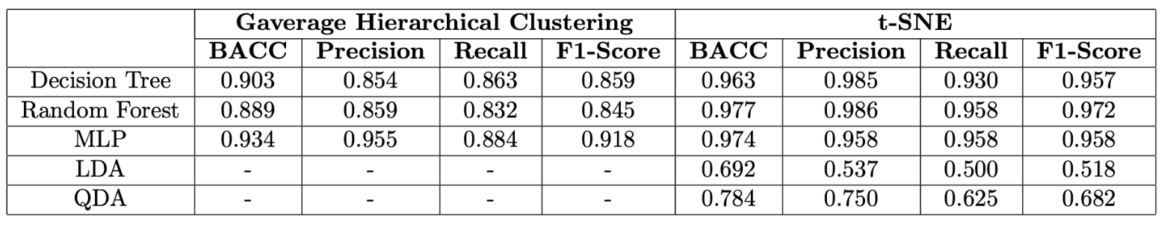
Supervised Learning on Clustering
Supervised Learning results obtained on cluster labels prediction:

Slide 17

Discussion and Conclusions
Discussion of the relevance of the final dataset variables;
Analysis of the pertinence of the root nodes of the decision tree;
Medical insights behind each variable and its influence.

Slide 18
Thank you for your attention!

